Slide 1
Chapter 4:
Direction and Weights
A First Course in Network Science

Slide 2
Directed/weighted networks
Many real-world networks are directed and/or weighted
We have seen several examples:
Links in food webs go from prey to predator and represent amount of prey/energy consumed
Web and Wikipedia links go from source to target page and may have weights representing clicks
Social network links may be weighted by numbers of interactions: retweets, mentions, likes, comments, etc.

Slide 3
Outline
Directed networks
The Web
PageRank
Weighted networks
Information and Misinformation Spread
Co-Occurrence Networks
Weight Heterogeneity

Slide 4
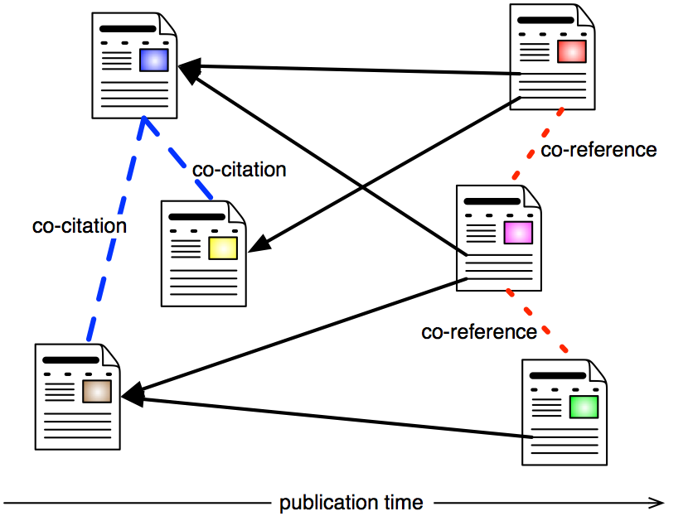
Directed networks
Link from source to target
Node degree is split into in-degree and out-degree
Paths must respect link directions
Examples:
Email, Web, Wikipedia
In a citation network, nodes are scholarly articles and links represent citations of references
Direction must be consistent with publication time

Slide 5
The (World-Wide) Web
Not the same as the Internet!
Web link graph or just Web graph:
Nodes are Web pages identified by URLs
Links are hyperlinks
Host graph (or site graph):
Nodes are websites (identified by hostname or domain name)
Link between sites if any hyperlinks between respective pages
Wikipedia is a subnetwork of the Web link graph

Slide 6
Web history
The idea of hypertext existed for many decades before the Web was invented, but bi-directional links where difficult to implement: needed centralized authority and control
Tim Berners-Lee in the early 1990s introduced the WWW model with one-directional hyperlinks from the source page
Easy to implement in distributed fashion without worrying about reciprocity from the target page or persistence (broken links okay)
Berners-Lee contributed three key ingredients of the Web:
URLs: Uniform Resource Locators, page addresses to link to pages
HTML: HyperText Markup Language to write web pages
HTTP: HyperText transfer Protocol for web clients and servers to communicate

Slide 7
Web history
Initially few people and organizations knew how to set up servers and write web pages, then many developments lowered the learning curve and cost for producing/sharing information:
Virtual hosting
Blogs
Wikis
Web 2.0, social tagging and sharing
Social media
Microblogs (Twitter, Facebook, etc.)

Slide 8
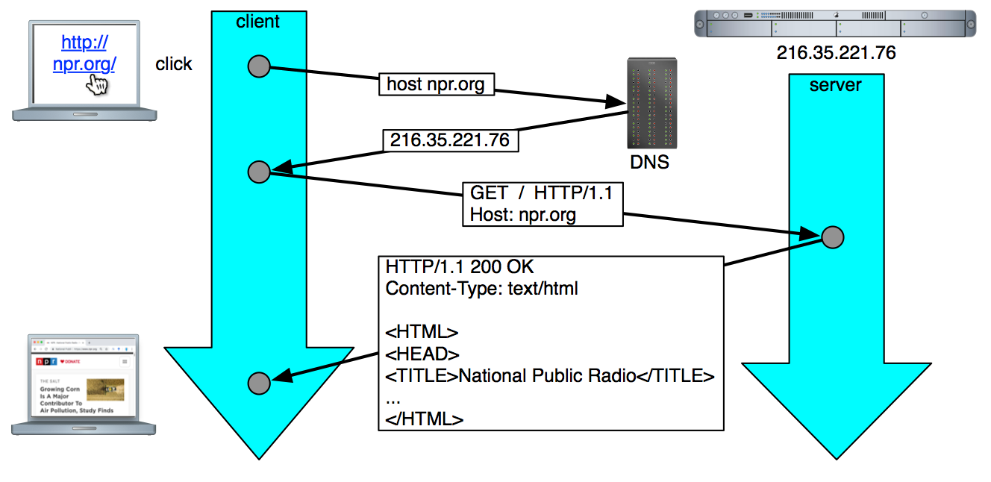
How the Web works

Slide 9
Web crawlers
Web client: any program that accesses information on the Web using HTTP to connect to a Web server
The most familiar client is the Web browser
Web crawlers: programs that automatically download Web pages
The primary application of crawlers are search engines
Crawlers collect information, scattered across billions of pages served by millions of servers around the globe, to a central location where it can be analyzed and mined
A search engine takes the information collected by a crawler and creates an index to efficiently retrieve pages that contain keywords and phrases queried by users
The Web changes rapidly, so search engines use crawlers to stay fresh information as pages and links are added, deleted, moved, and updated
Other applications: business intelligence, digital libraries, webometrics tools, research
Malicious applications: harvesting email addresses and personal information for spam, phishing, and identity theft

Slide 10
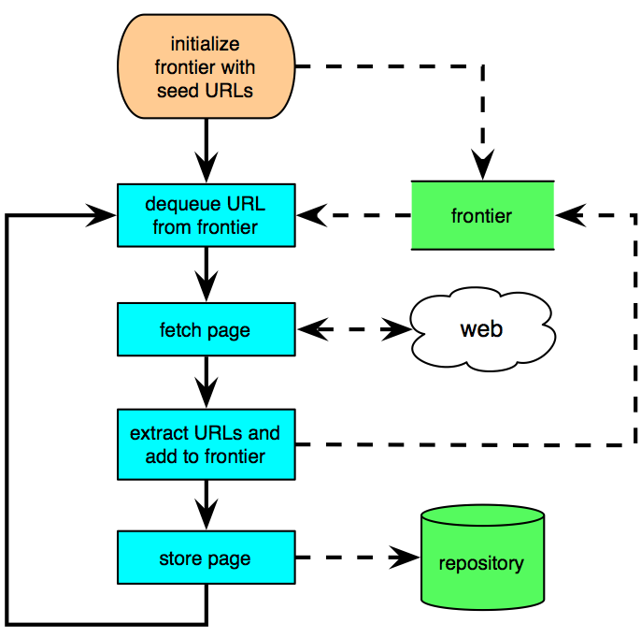
Web crawler
The basic concept of crawler is simple: a breadth-first traversal of the Web graph, as in the BFS algorithm we saw in previous chapters
Start from a set of high-quality seed pages
The queue of unvisited URLs is called frontier
Fetch pages dequeued from the frontier, extract links and add them to the frontier
Devil in the details: complications due to scalability, page revisit scheduling, spider traps, canonical URLs, robust HTML parsing, and the ethics of dealing with servers

Slide 11
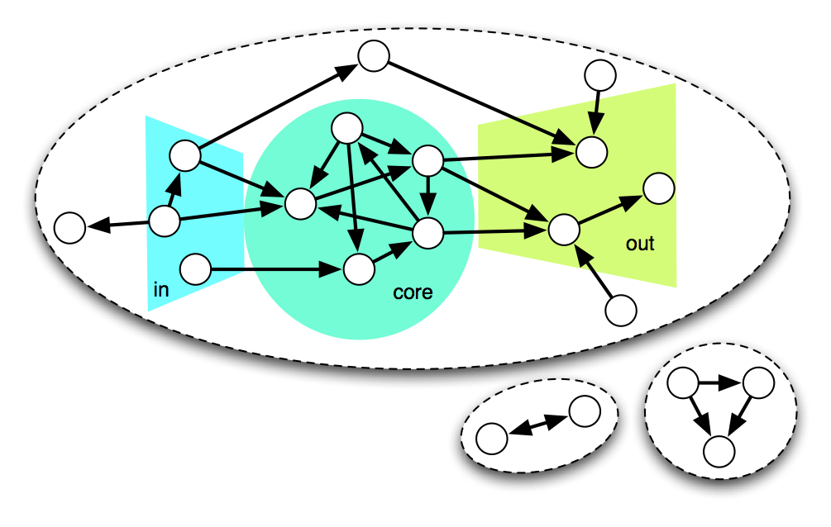
Web graph structure
Bow-tie structure
A giant strongly connected component (a.k.a. core)
In- and out-component that together with the core make up the giant weakly connected component (>90% pages)
Many smaller components

Slide 12
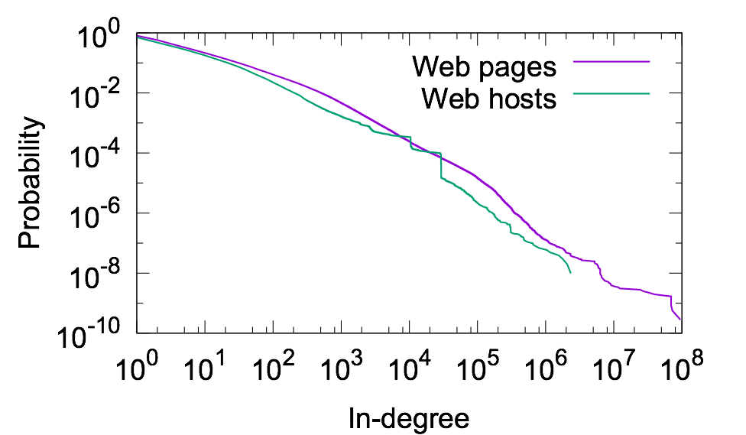
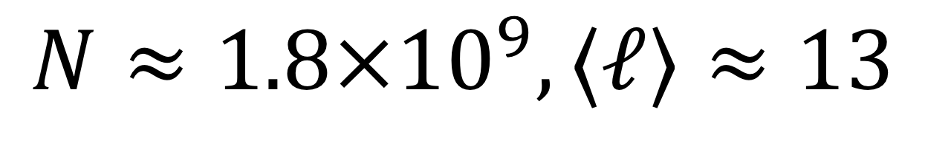

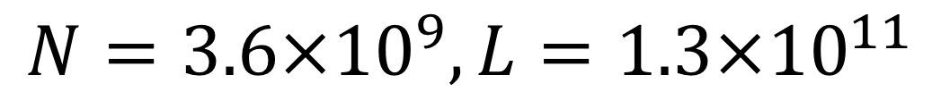
Web degree distributions
We focus on in-degree distribution, which arises from collective behavior of authors
Heavy tail with huge hubs:
In-degree distribution is less meaningful as it depends on individual content providers and can be gamed
Eg, link farms for spamdexing
Short paths in core:
$$⟨k_{in}⟩≈10,κ≈40$$
$$N=3.6×{10}^{9},L=1.3×{10}^{11}$$
$$N≈1.8×{10}^{9},⟨ℓ⟩≈13$$

Slide 13
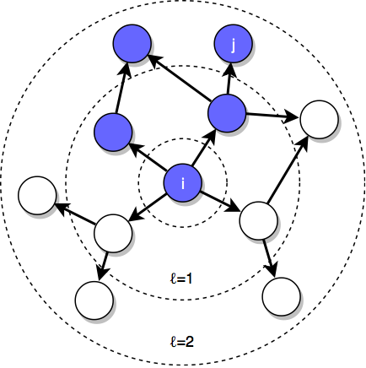
Topical locality
Homophily for the Web: pages about related topics tend to link to each other
Links are not random!
We can think of similarity based on textual content or categorical topics
Topic drift: as we browse away from a starting page, the similarity decreases
Topical locality makes Web browsing possible as we stay on topic
Crawlers use BFS because of topical locality, to target good-quality pages linked by other good-quality pages

Slide 14
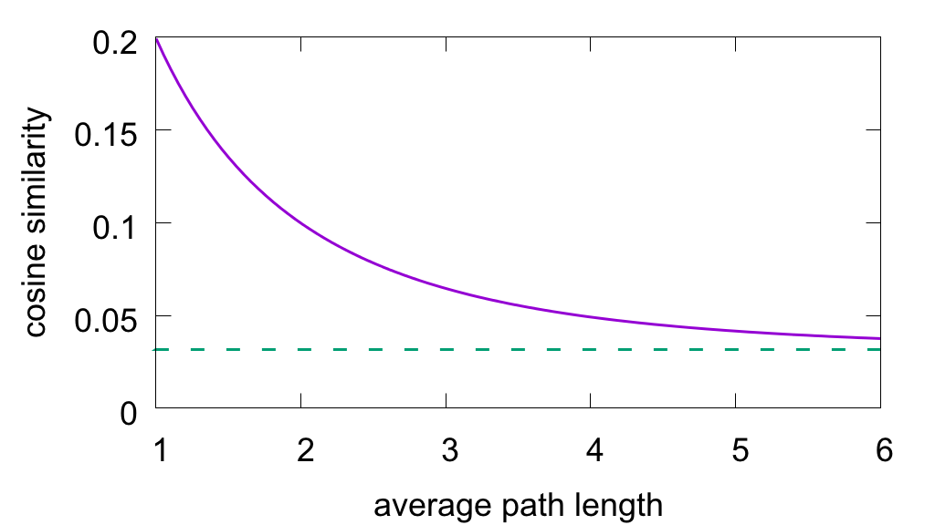
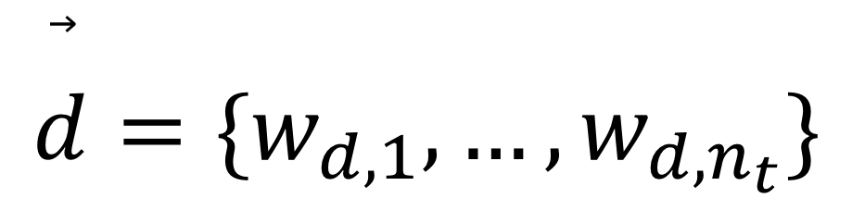
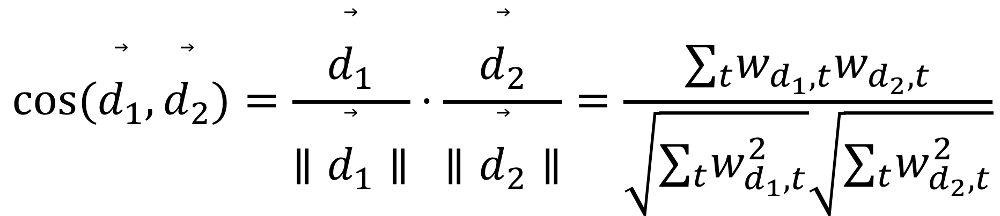
Cosine similarity
Vector space model: textual content of each page is represented as a vector:
One dimension for each term in vocabulary (high-dimensional space!)
Remove or give lower weights to terms that are very common and therefore not meaningful
Or use deep learning to embed pages in lower-dimensional Euclidean space
Measure similarity between two pages based on angle between vectors
$$cos(\overset{⃗}{d_{1}},\overset{⃗}{d_{2}})=\frac{\overset{⃗}{d_{1}}}{∥\overset{⃗}{d_{1}}∥}⋅\frac{\overset{⃗}{d_{2}}}{∥\overset{⃗}{d_{2}}∥}=\frac{∑_{t}w_{d_{1},t}w_{d_{2},t}}{\sqrt{∑_{t}w_{d_{1},t}^{2}}\sqrt{∑_{t}w_{d_{2},t}^{2}}}$$
$$\overset{⃗}{d}=\{w_{d,1},…,w_{d,n_{t}}\}$$

Slide 15
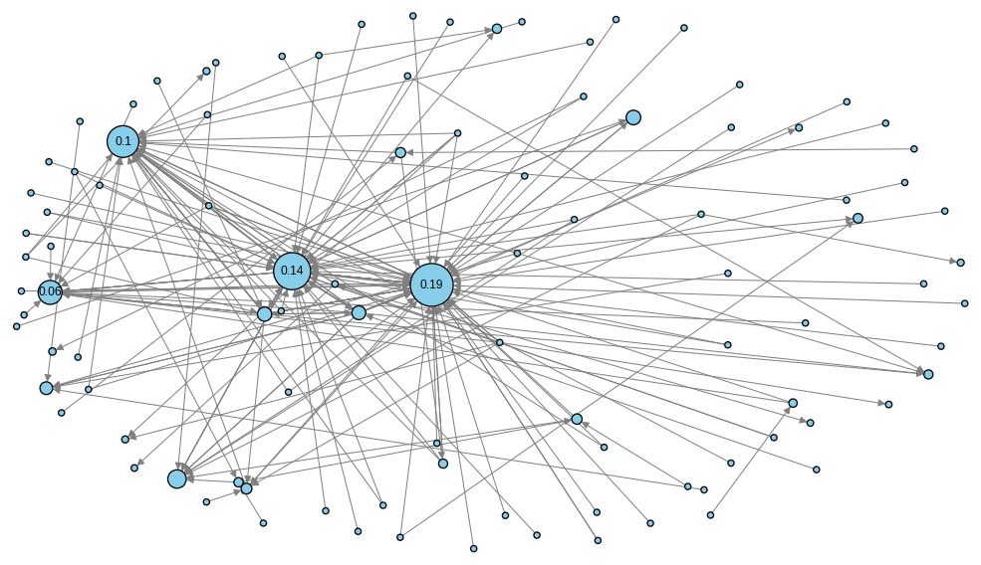
PageRank
A centrality measure for nodes in directed networks
Used to calculate importance, or prestige, or Web pages
Search engines need it to rank pages that seem equally relevant based on content
Sergey Brin and Larry Page introduced PageRank in 1998 as a key ingredient of Google
PR_dict = nx.pagerank(D) # D is a DiGraph

Slide 16




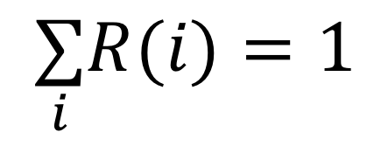
PageRank
Random surfer model: browse the Web at random
A random link is clicked from each page to get to the next
Random walk model modified with random jumps (teleportation)
At each step, with probability α, stop browsing and start new session form a random page
Recursive definition
PageRank is conserved, neither created nor destroyed:
Power method to calculate PageRank:
Initialize each node with
At each iteration t, loop over nodes and update PageRank of each node i via this recursive equation:
$$R_{0}=1/N$$
$$R_{t}(i)=\frac{α}{N}+(1−α)\underset{j∈\text{pred}(i)}{∑}\frac{R_{t−1}(j)}{k_{out}(j)}$$
probability to land on i by teleportation
probability to land on i by random surfing
$$\underset{i}{∑}R(i)=1$$

Slide 17
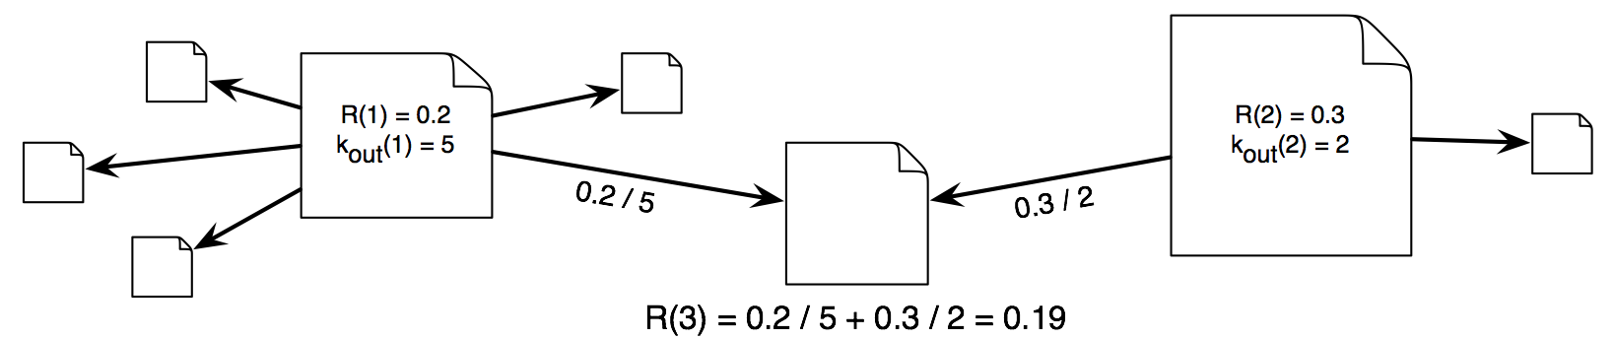

PageRank
α is the teleportation or jump factor, typically 0.15
PageRank converges quickly (in few iterations) if α > 0
1– α is the damping factor
Example with α = 0:
$$R_{t}(i)=\underset{j∈\text{pred}(i)}{∑}\frac{R_{t−1}(j)}{k_{out}(j)}$$

Slide 18
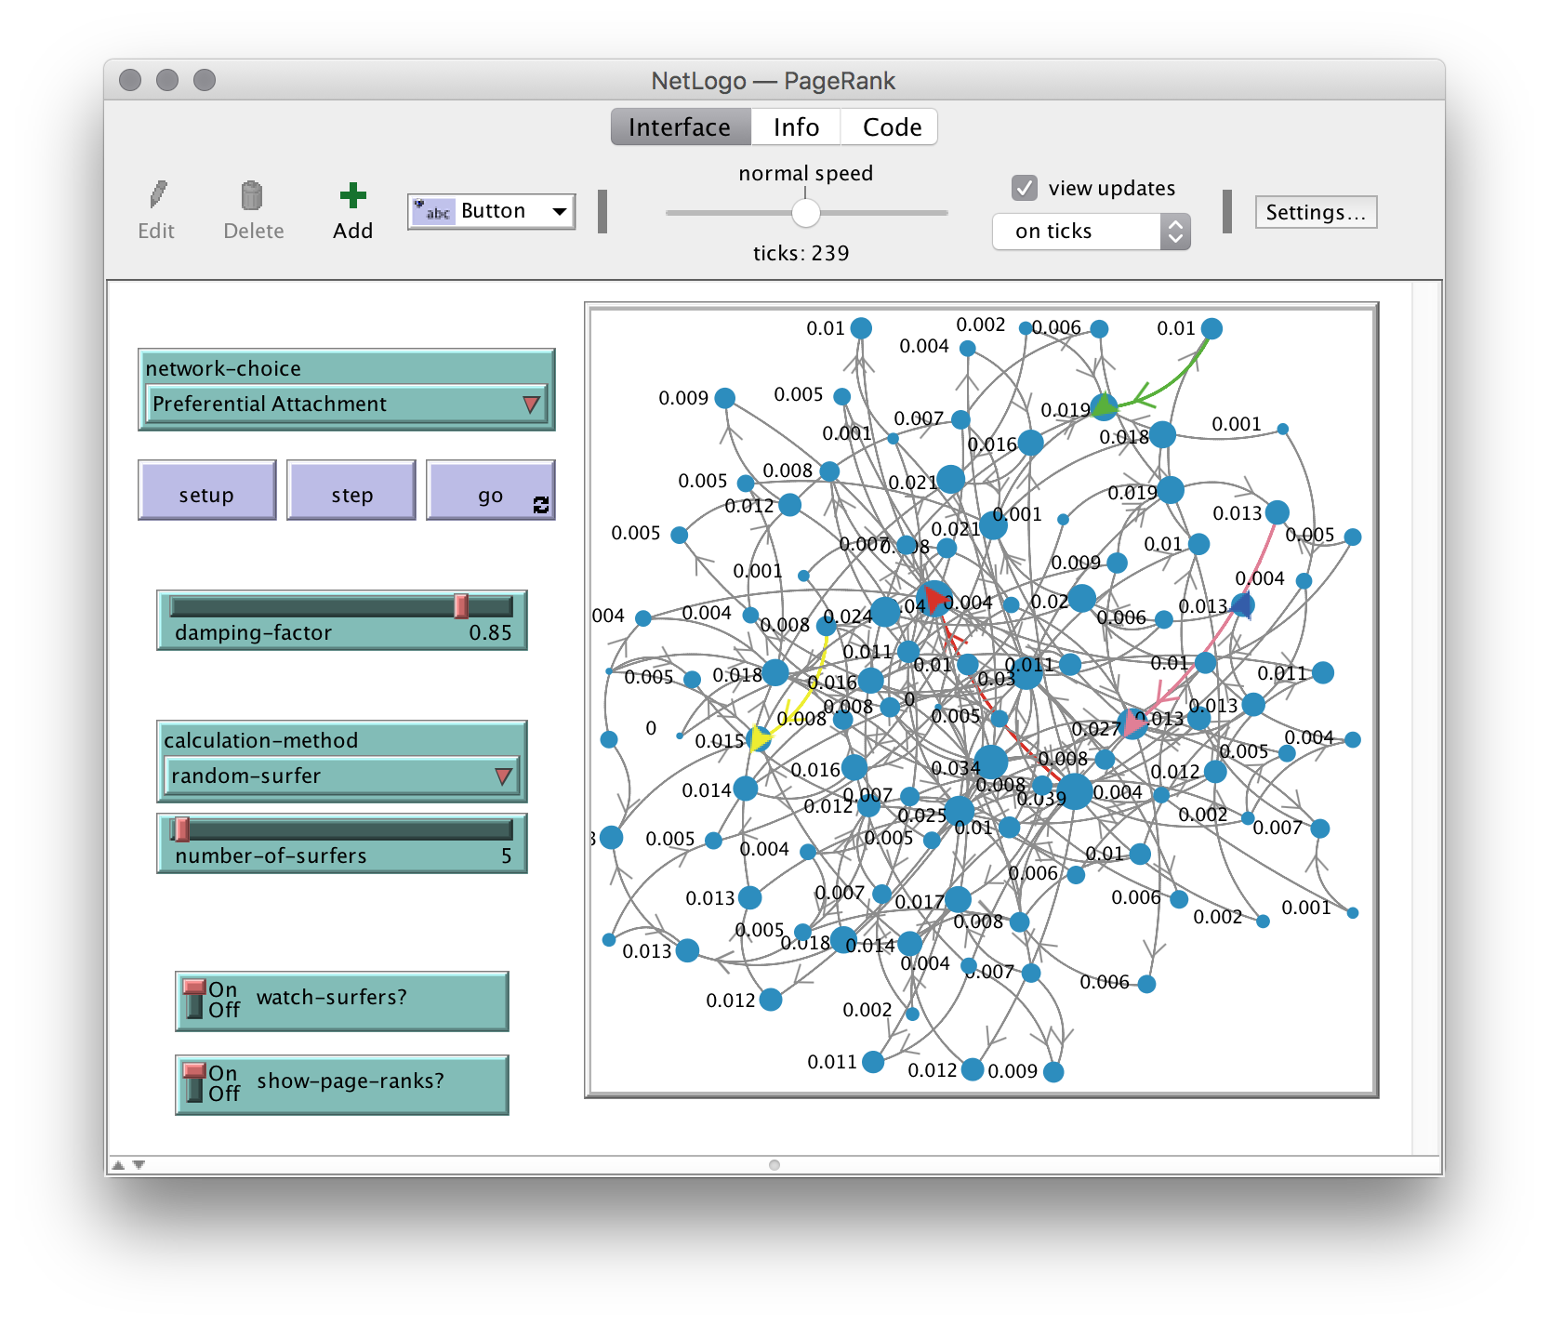
NetLogo:
PageRank

Slide 19
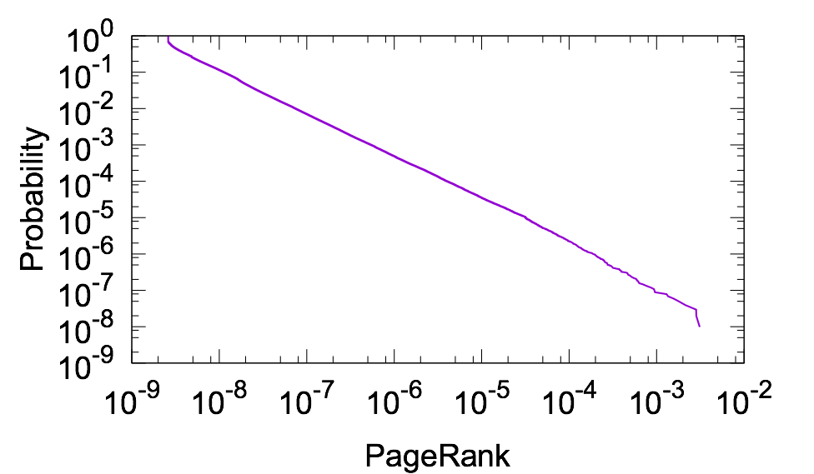
PageRank vs in-degree
PageRank distribution is very skewed, similar to that of in-degree
PageRank is similar to in-degree to a first approximation (if all incoming links originate from pages with the same PageRank)
But links from more important pages bring more importance
Search engine optimization (SEO) companies try to boost a client website's PageRank
Unscrupulous SEOs may use spamdexing but if caught by search engines, client can be de-listed

Slide 20
Weighted networks
Many real-world networks (directed and undirected) have link weights:
Twitter diffusion: number of retweets between two users
Email: number of messages
Internet: data (bits) exchanged between routers
Air transportation: number of passengers
Brain: firing rate between neurons
Food webs: biomass
You can think of weights even in networks that we usually represent as unweighted:
Facebook friendships could be weighted by number of interactions (tags, likes, comments), common friends, etc.
The movie co-star network could be weighted by number of movies in which two stars have acted together
Wikipedia links can be weighted by number of clicks
Degree, in-degree and out-degree are extended to strength, in-strength, and out-strength

Slide 21

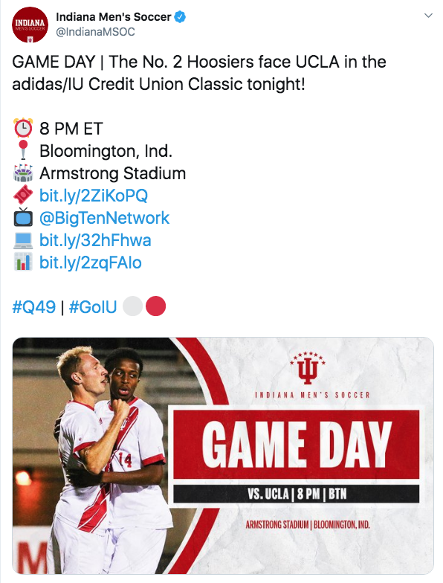
Information diffusion networks
Memes: transmissible units of information, such as ideas, behaviors, news links, hashtags, and, yes, also images with captions (image macros)
The definition of meme is due to Richard Dawkins, in analogy to genes transmitted from parent to offspring
Like genes, memes can mutate and have fitness
A tweet can carry several memes
links
mentions
hashtags
media

Slide 22
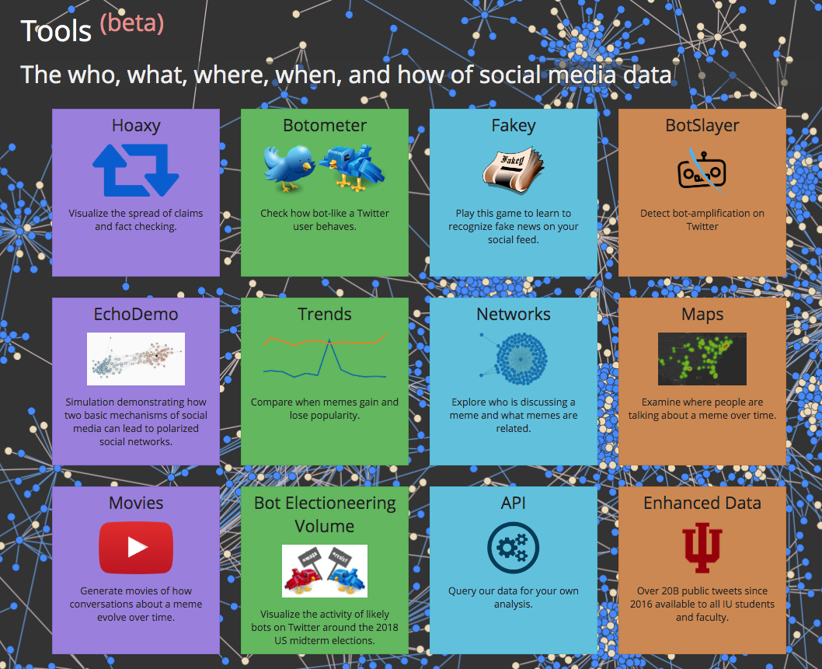
Information diffusion networks
We can track, map, and analyze the spread of memes on Twitter
Retweet network: link from retweeted user to retweeter user
Mention/reply network: link to user who replies or who is mentioned
Tweets are time-stamped; we can aggregate the temporal networks
Can focus on a particular meme (eg, a hashtag) or multiple ones (eg, a set of accounts or links to a news source)
Play with the interactive diffusion network tools at osome.iuni.iu.edu

Slide 23
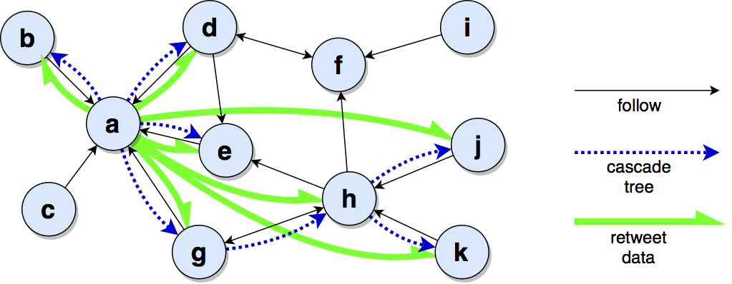
Retweet networks
In the data, each retweet cascade network is a star (all retweets point to original tweet)
The actual cascade tree is difficult to reconstruct, but we can make some guesses based on the follower network and timestamps

Slide 24
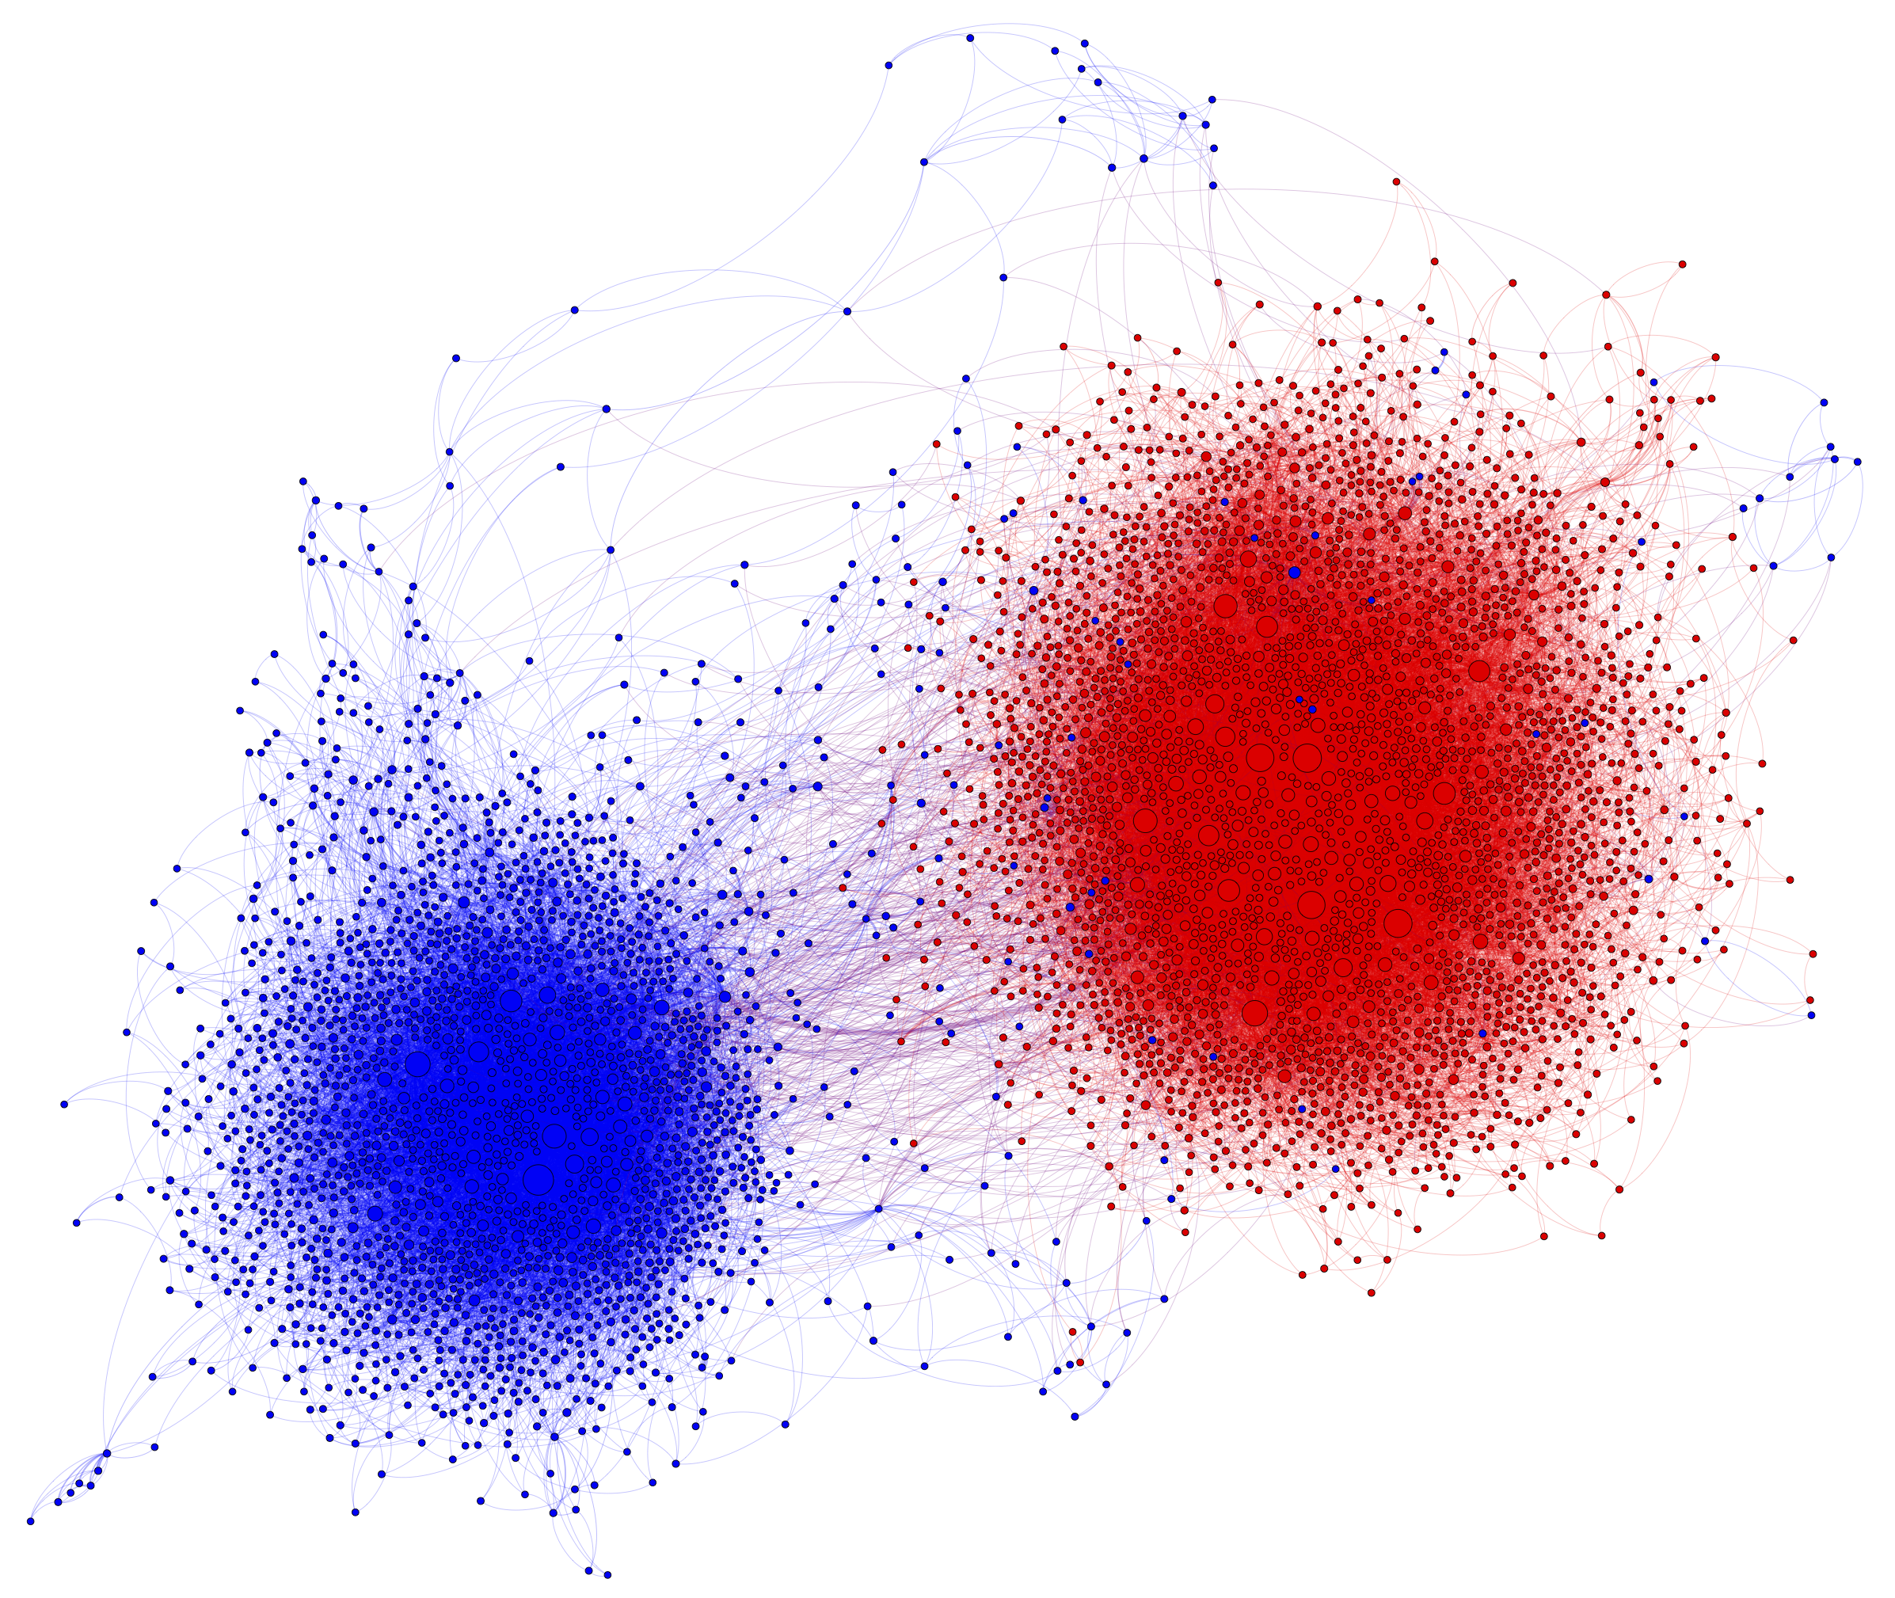
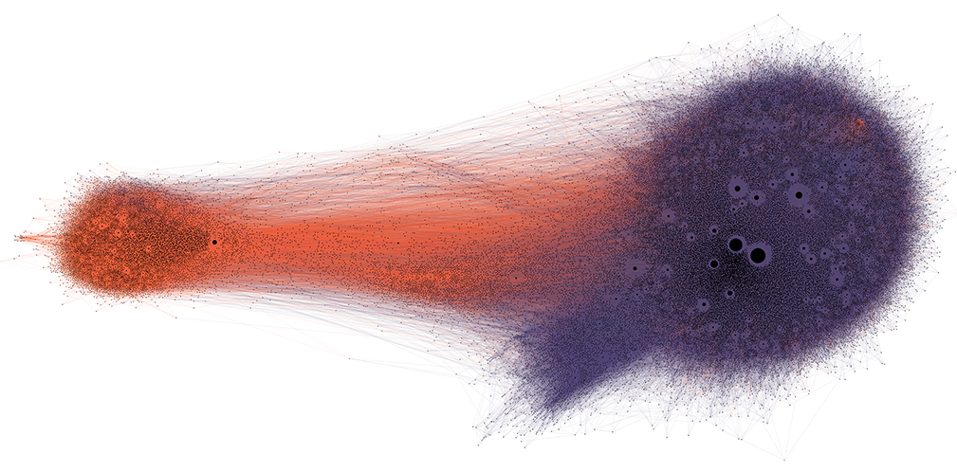
Echo chambers
Examples:
Retweets of tweets with progressive (blue) and conservative (red) political hashtags during 2010 US election (k=3 core)
Retweets of tweets with links to low-credibility (purple) and fact-checking (orange) sources during 2016 US election (k=5 core)

Slide 25

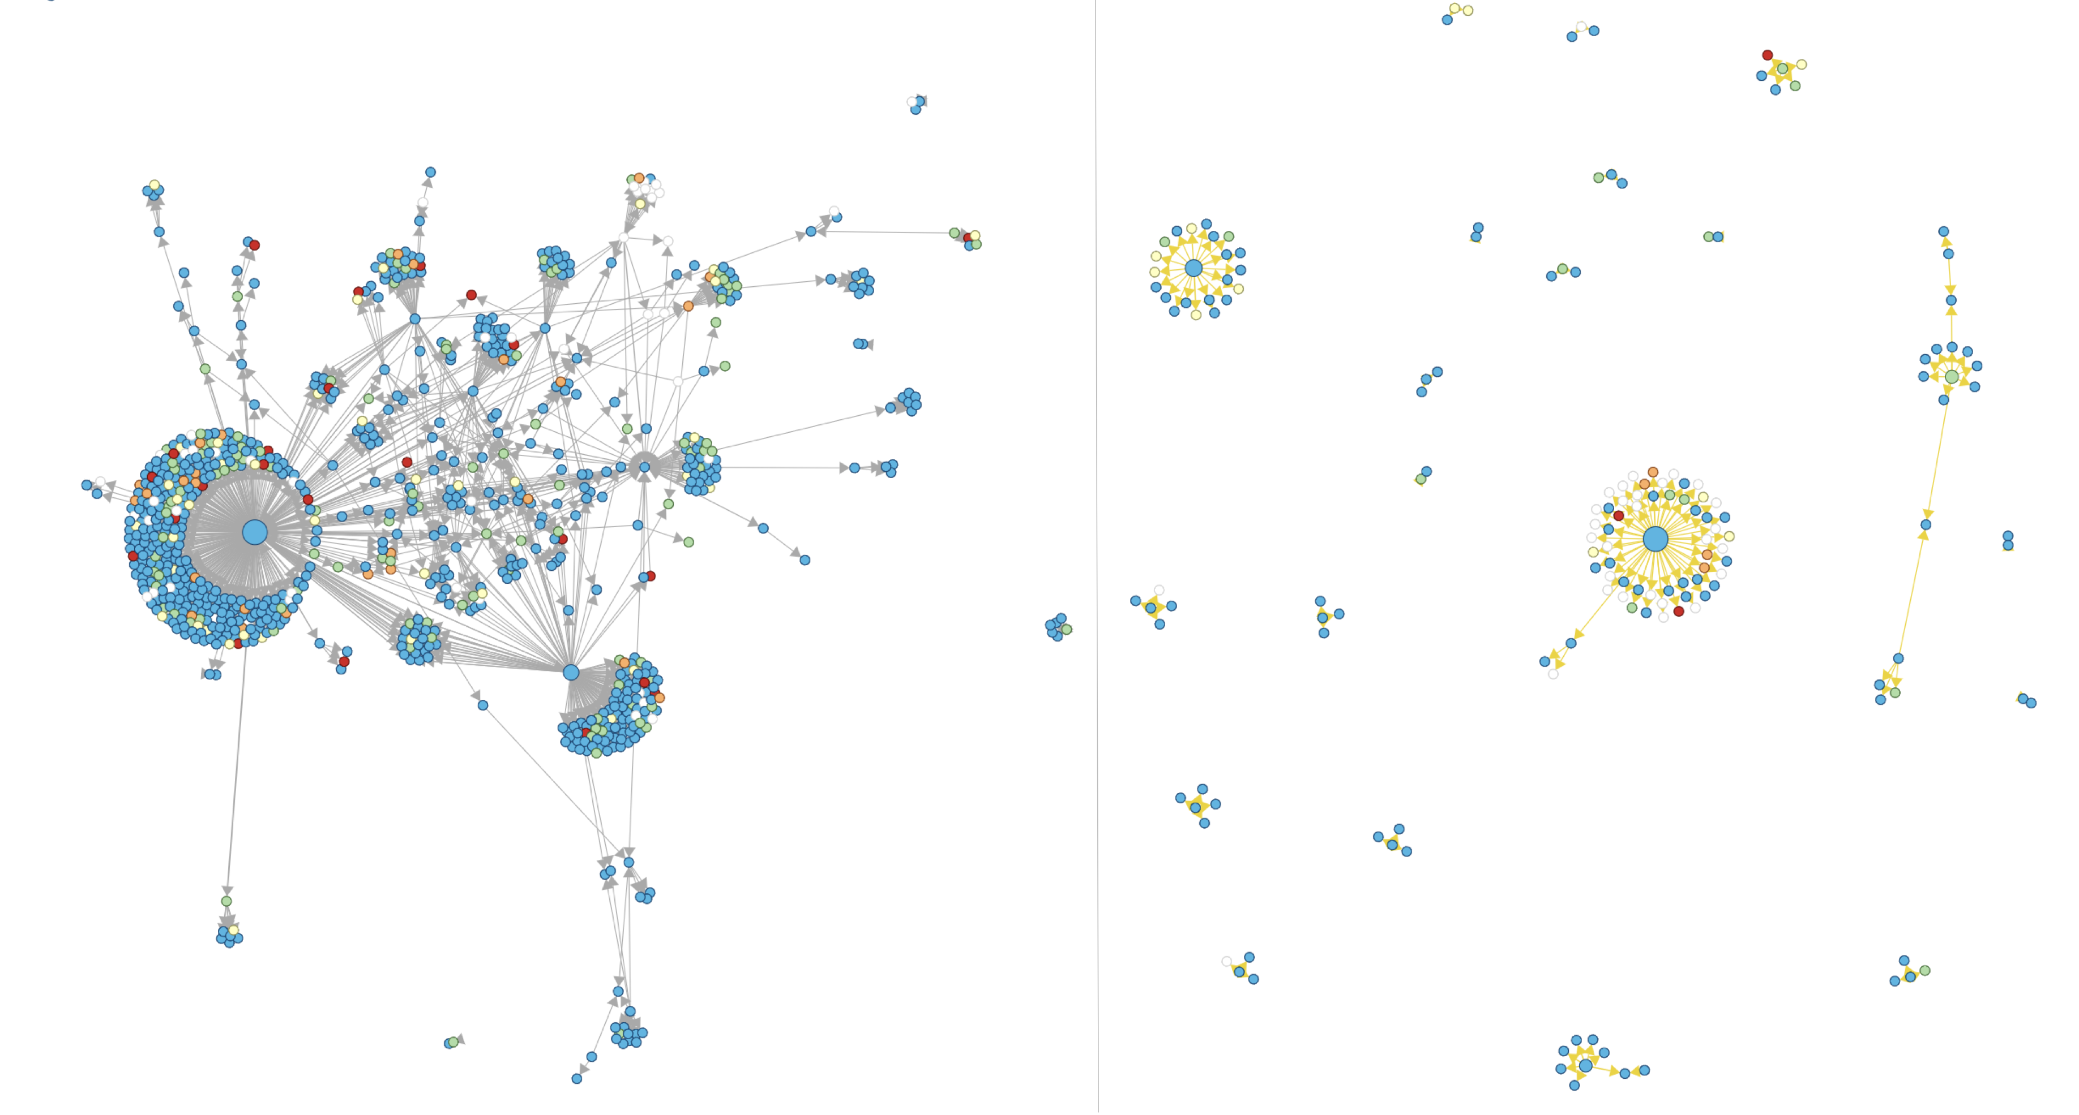

Virality
facts about White Helmets
misinformation about White Helmets
Multiple ways to measure the virality of a meme:
Number of users exposed
Depth of diffusion tree
Fraction of users who retweet to users who are exposed
Misinformation is often more viral than actual news reports
Source: hoaxy.iuni.iu.edu

Slide 26

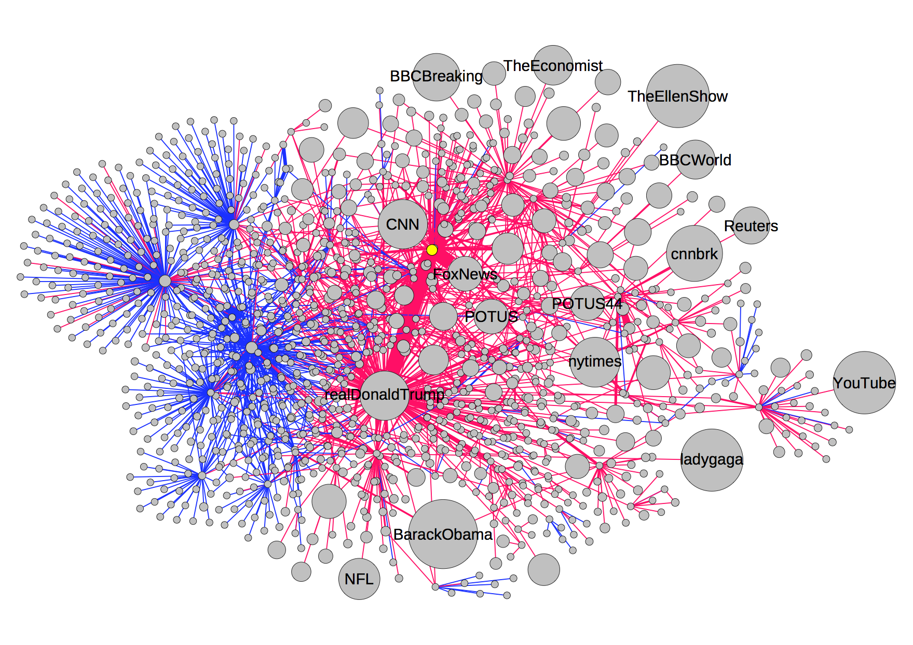
Influence
Bot (yellow node) replies to tweets mentioning an influential user (@realDonaldTrump) and links to fake news article
Multiple ways to measure the influence of an account:
Number of followers (in-degree in follower network)
Number of users exposed (out-degree in retweet network)
Number of retweets (out-strength in retweet network)
Fraction of retweets to followers
Social bots can target influential accounts hoping for retweet
Blue links: retweets and quotes. Red links: mentions and replies. Node size: number of followers.

Slide 27
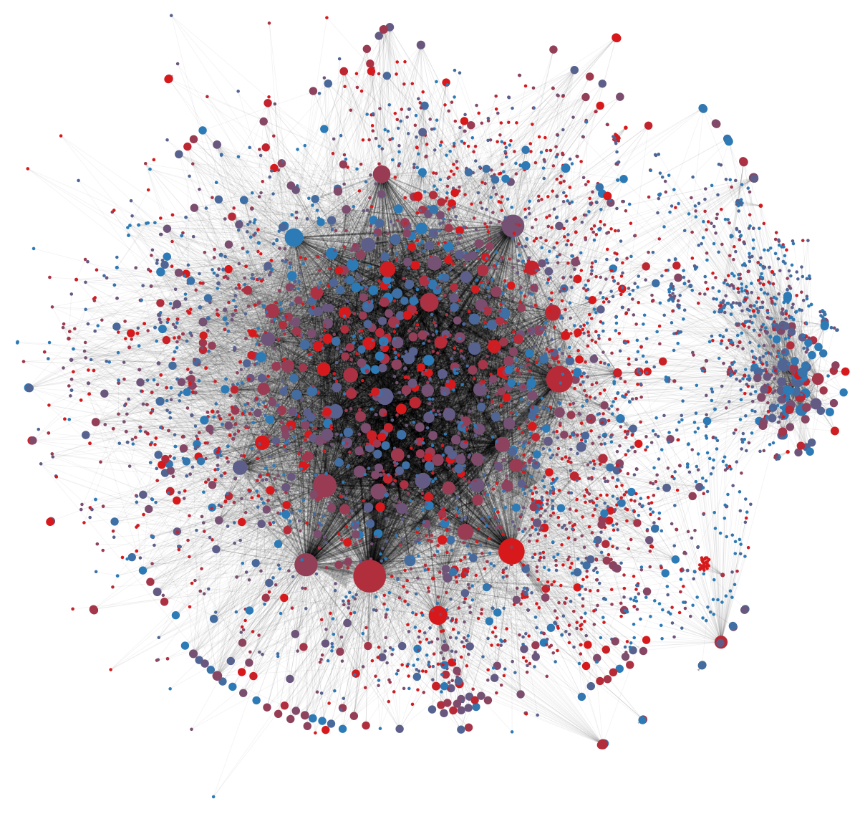
Social bots
Accounts controlled by an entity via software
Malicious social bots can impersonate humans, deceive, and manipulate diffusion networks:
Fake followers
Amplification: fake retweets
Astroturf: appearance of organic virality
All social media platforms and users are vulnerable
Large red nodes: influential bots manipulating online debate about vaccination policy

Slide 28
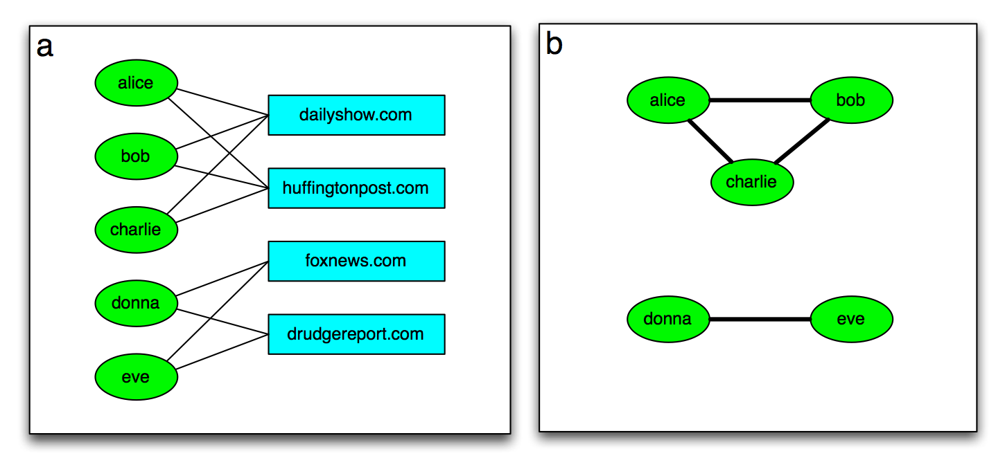
Co-occurrence networks
Weight can originate from relationships between more than one type of entity
Nodes in a bipartite network co-occur if they share common neighbors
Projection: keep nodes from either group of bipartite network and add edges among co-occurring nodes
Examples:
From star-movie network to co-star network
From 'like' data to friend recommendations
From music listening data to similar-song recommendations
From purchase data to product advertising ("people who bought this also bought…")

Slide 29
Co-citation and co-reference
Think of any directed network as a bipartite network with sources and targets as two groups of nodes
nodes with both incoming and outgoing links can appear in both groups
Count the number of shared successors or shared predecessors and use it as a weight between nodes in the same group
Co-citation network: shared predecessors (cited by same papers)
Co-reference network: shared successors (citing same papers)

Slide 30
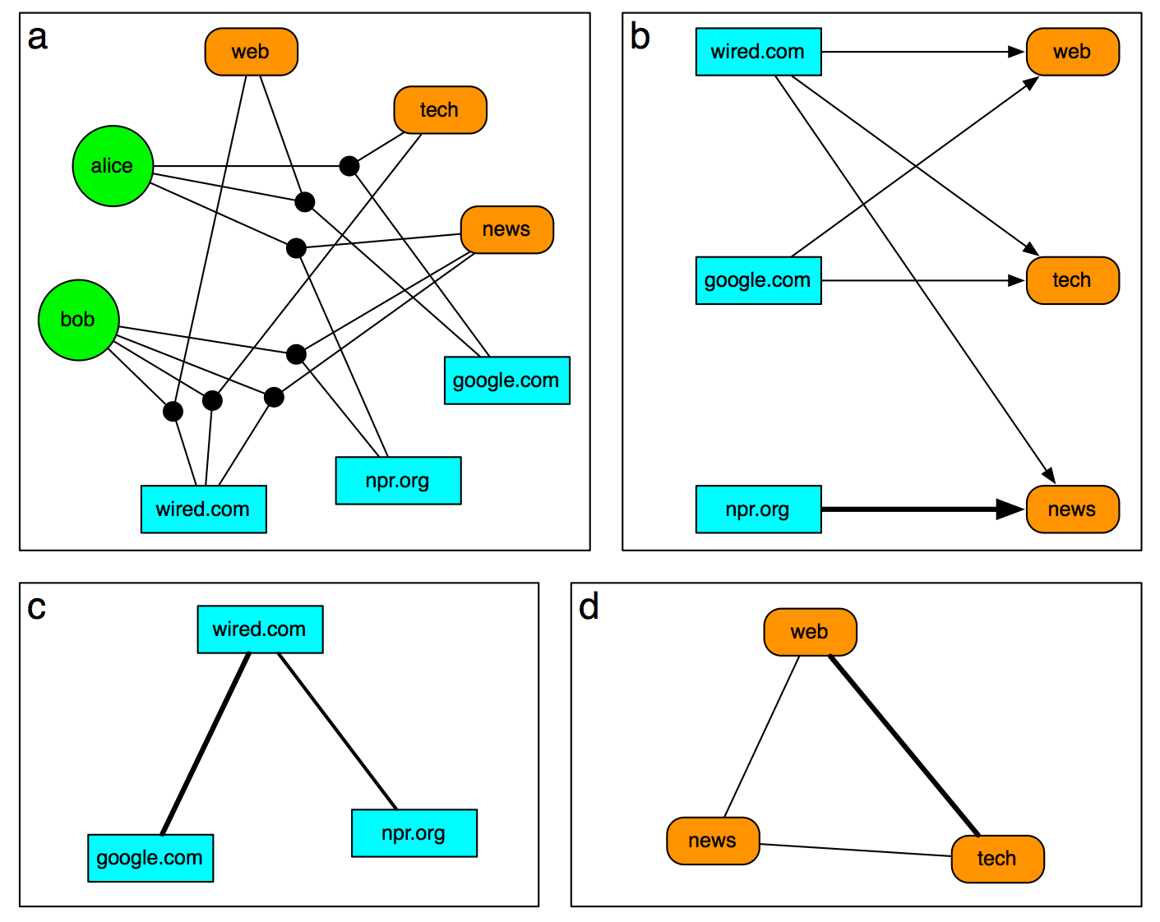
Social tagging
Folksonomy: set of triples (user, resource, tag) where user assigns tag to resource
Resource can be any URL, e.g., photos on Flickr
Implicit in social media, e.g. #hashtags on Twitter
Tripartite network: each link connects three nodes from distinct sets
Can project based on common neighbors
First stage: project to weighted bipartite network
Second stage: project to weighted network; cosine similarity is one way to compute weights
Check out osome.iuni.iu.edu/tools/networks/ for interactive Twitter hashtag co-occurrence networks

Slide 31
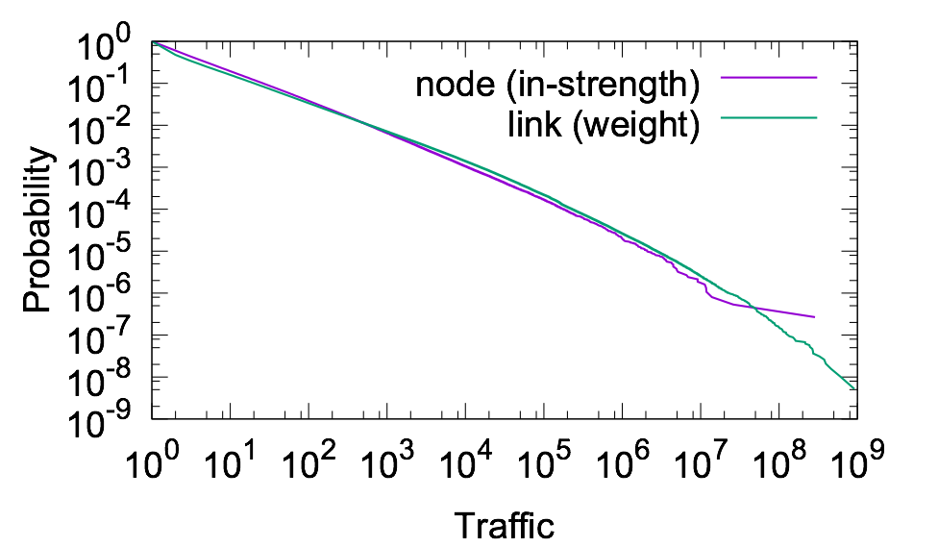
Weight heterogeneity
Weights can span many orders of magnitude
Example: Web traffic
Click data collected at IU
~100k anonymous users
~1B clicks
N ≈ 4M sites
L ≈ 11M weighted directed links
Both in-strength (sin) and weight (w) distributions have very heavy tails

Slide 32
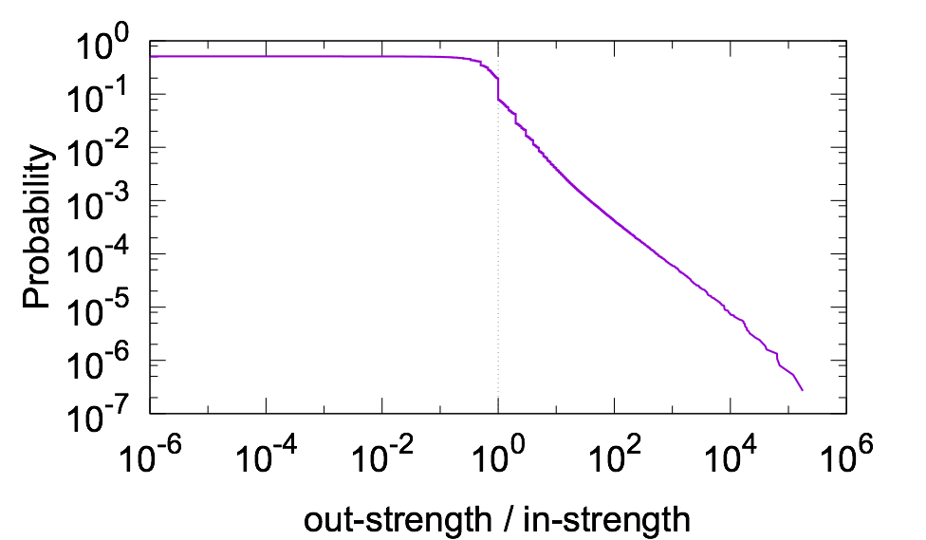
Weight heterogeneity
Comparing in-strength (traffic) distributions with that produced by PageRank, we find weak correlation
Therefore PageRank is not a very good model of Web traffic — Why?
Random jumps (teleportation) are responsible for most of the discrepancy
We start browsing from popular and familiar sites, not random nodes
We stop browsing at less-interesting pages, not random nodes
Some sessions are very long
PageRank
predicts
very narrow
distribution

Slide 33
Link filtering
There may be many links with very small weights, making a weighted network too dense to easily visualize or analyze
If low-weight links represent low-importance connections (or noise), we could filter them out to analyze a sparser network
Example: in a text-similarity network, two documents may have non-zero similarity due to generic words (and, the, etc.) that are not informative of what the documents are about
Easiest approach: remove links with weight below a threshold
Works well enough in many cases

Slide 34
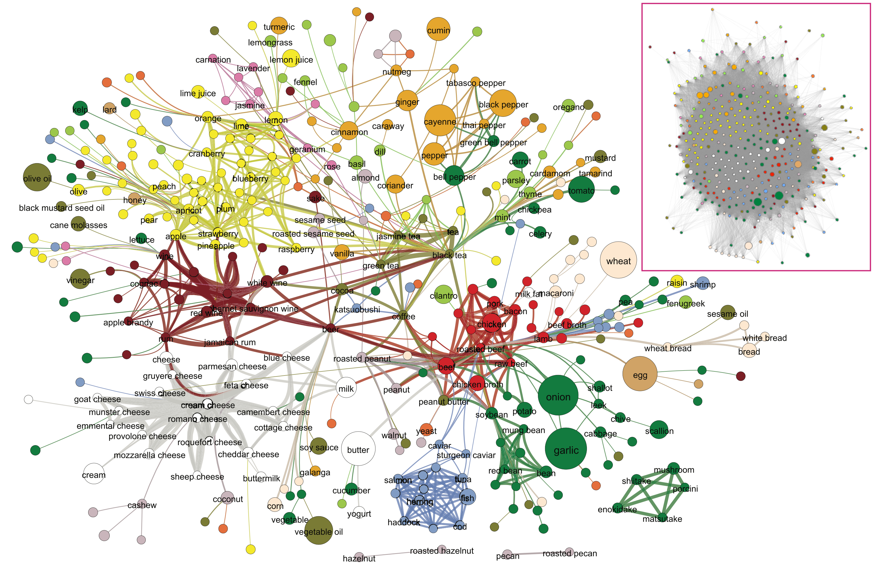
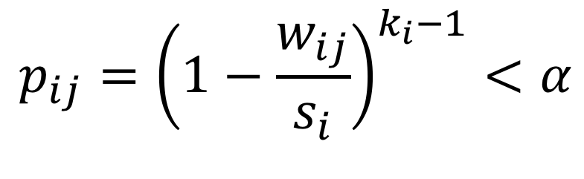
Network backbone
Dense flavor network
How to set the threshold to filter links?
In some cases, due to weight heterogeneity, a lot of information is lost by setting a threshold such that enough links are removed
Backbone: set a different threshold for each node, so that we remove links with weights that are not significant compared to the other links of that node
Compare probability of link weight, given degree and strength of node, to a significance threshold: keep links if
$$p_{ij}={\left(1−\frac{w_{ij}}{s_{i}}\right)}^{k_{i}−1}<α$$
Backbone flavor network with α = 0.04
Image DOI:10.1038/srep00196 CC BY 4.0

